Slide 1

Welcome to the ESO Call!
10am -11am CT
First Wednesday of Each Month

Slide 2
October ESO Call Agenda
I. Welcome
II. New Member Introductions
Please introduce yourself and let us know how we can connect with you.
III. Entrepreneurial Spotlight
Jakob Michalelis, CEO of Auxigen AI
IV. Program Updates
V. Community Announcements

Slide 3
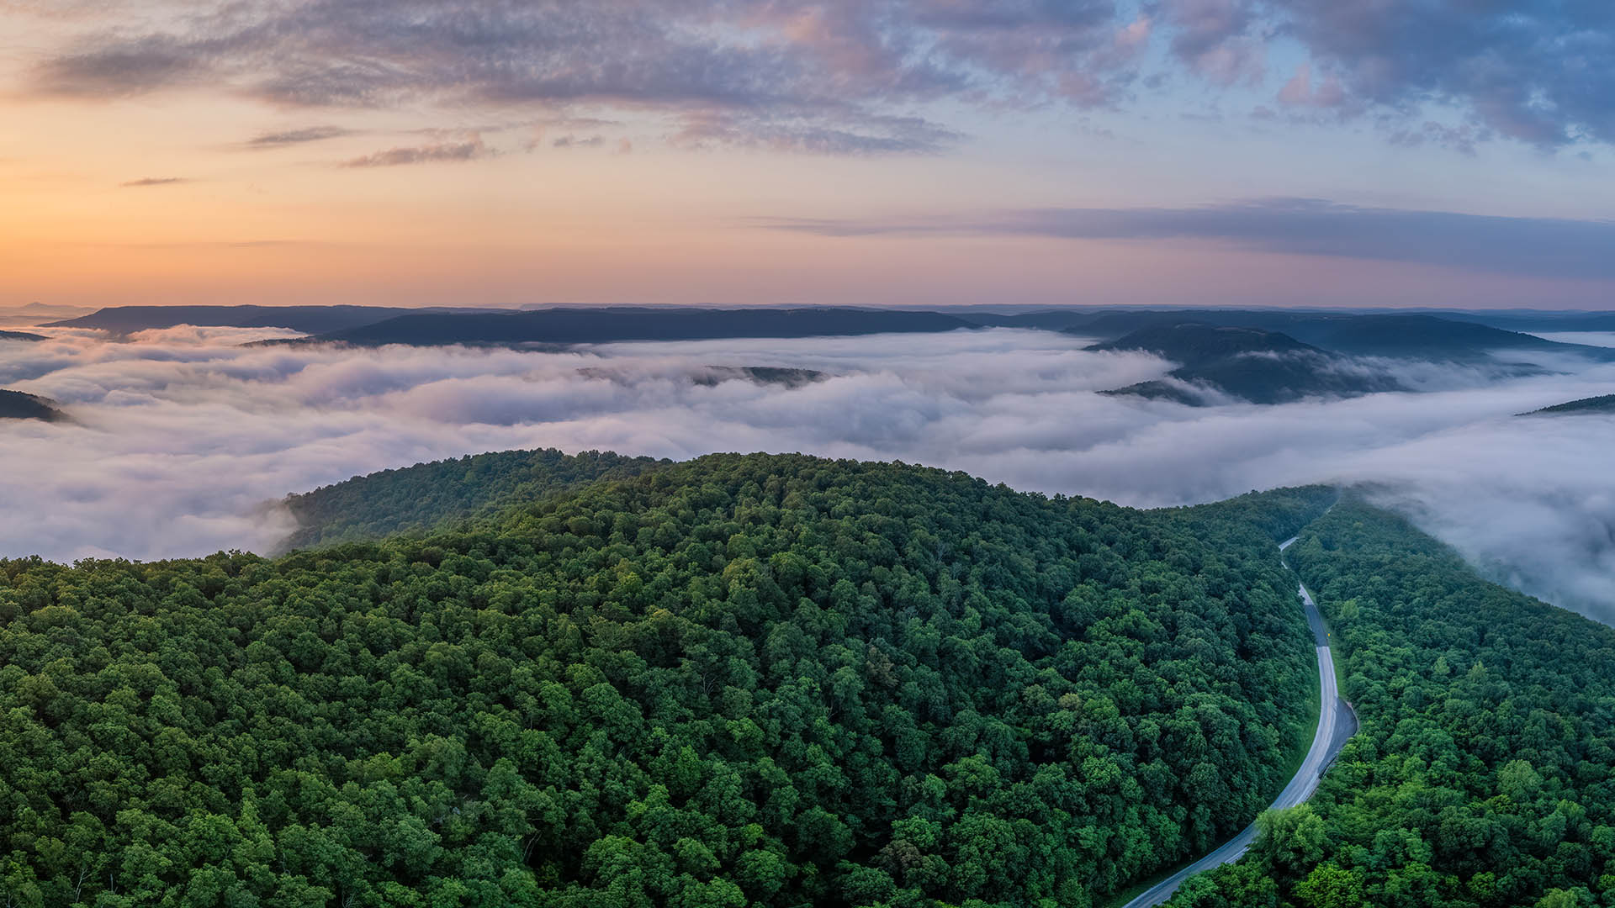




Considerations
We begin promptly at
10am CT on the ﬁrst Wednesday of each month. Calls are limited to one hour.
Meetings are recorded and will be made available upon request.
Please mute your microphones unless speaking.
If you have an announcement, please make sure you send it in our announcement link on our website.

Slide 4

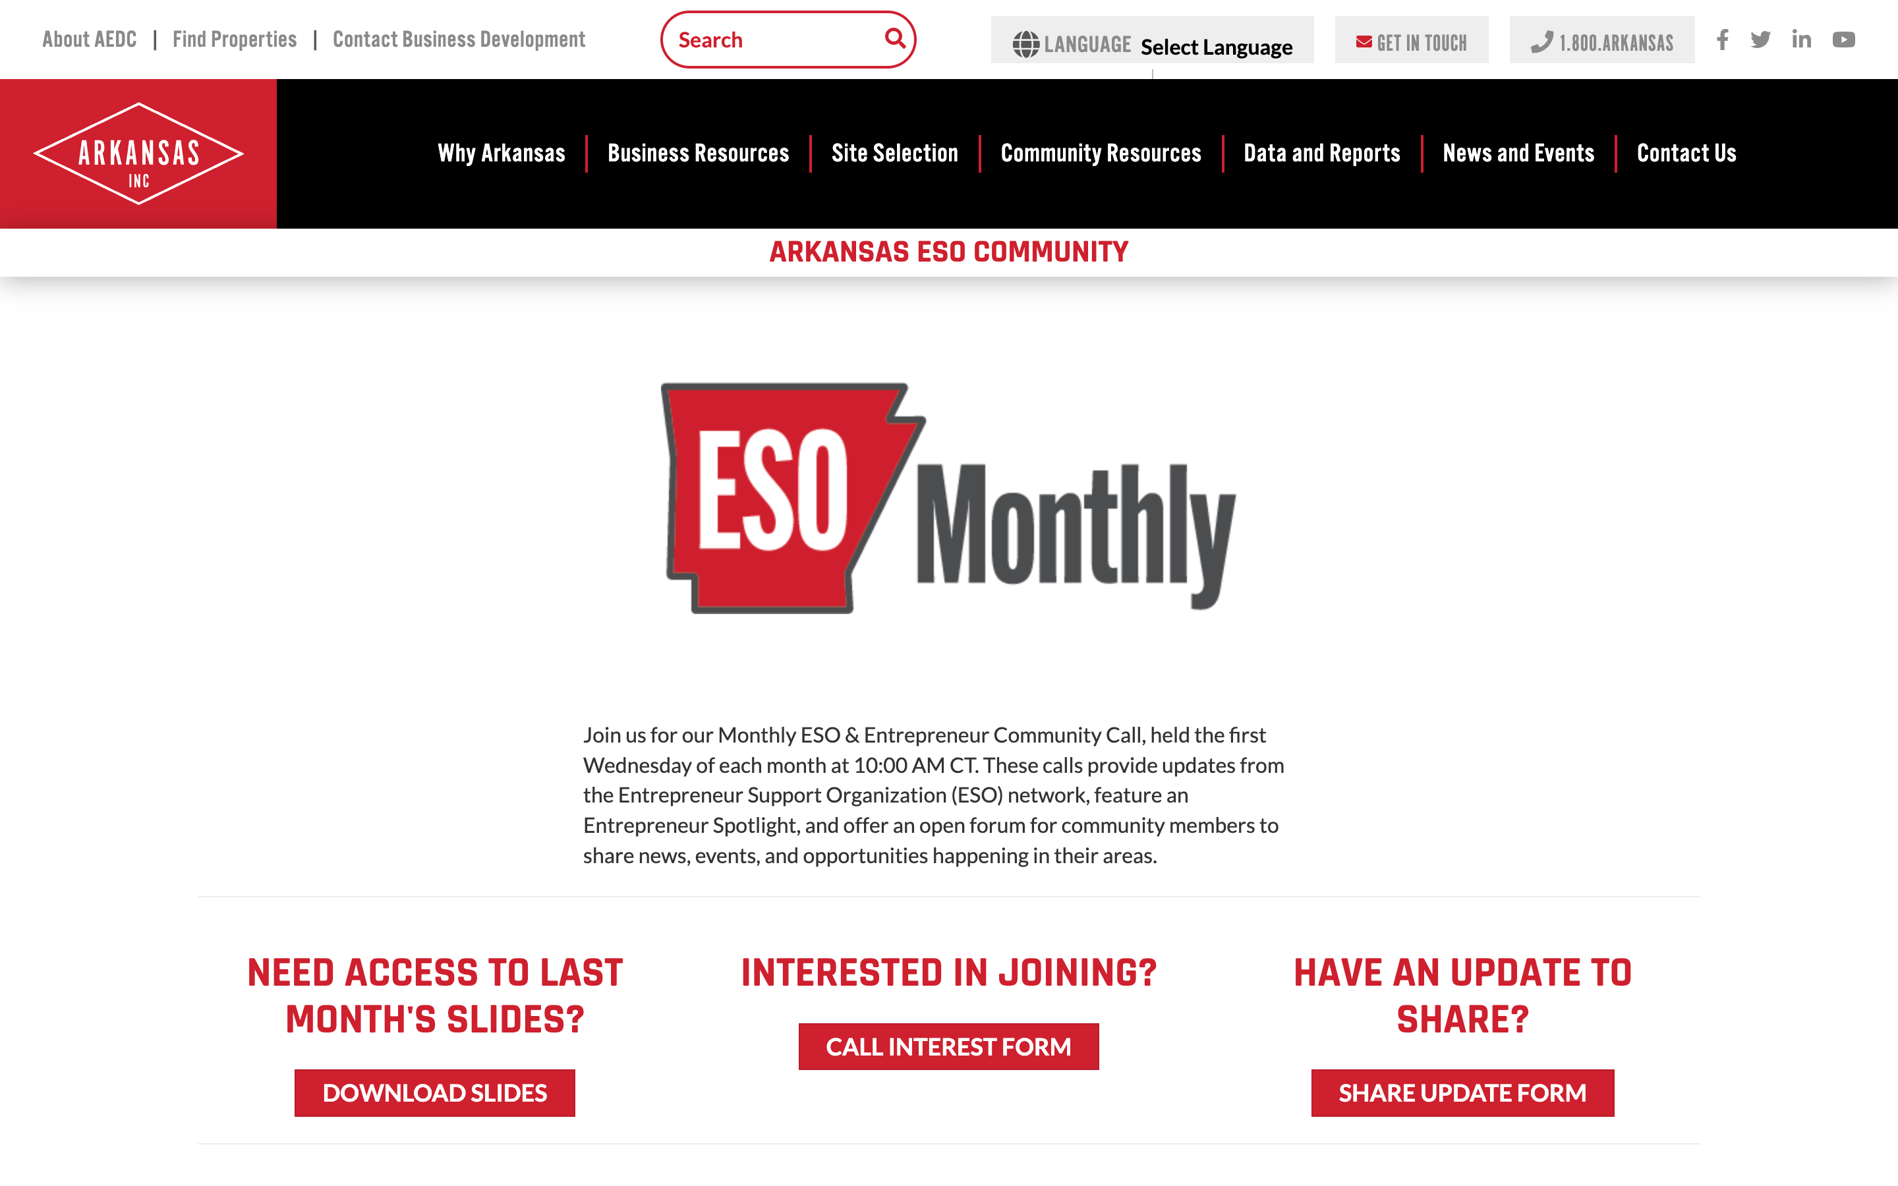
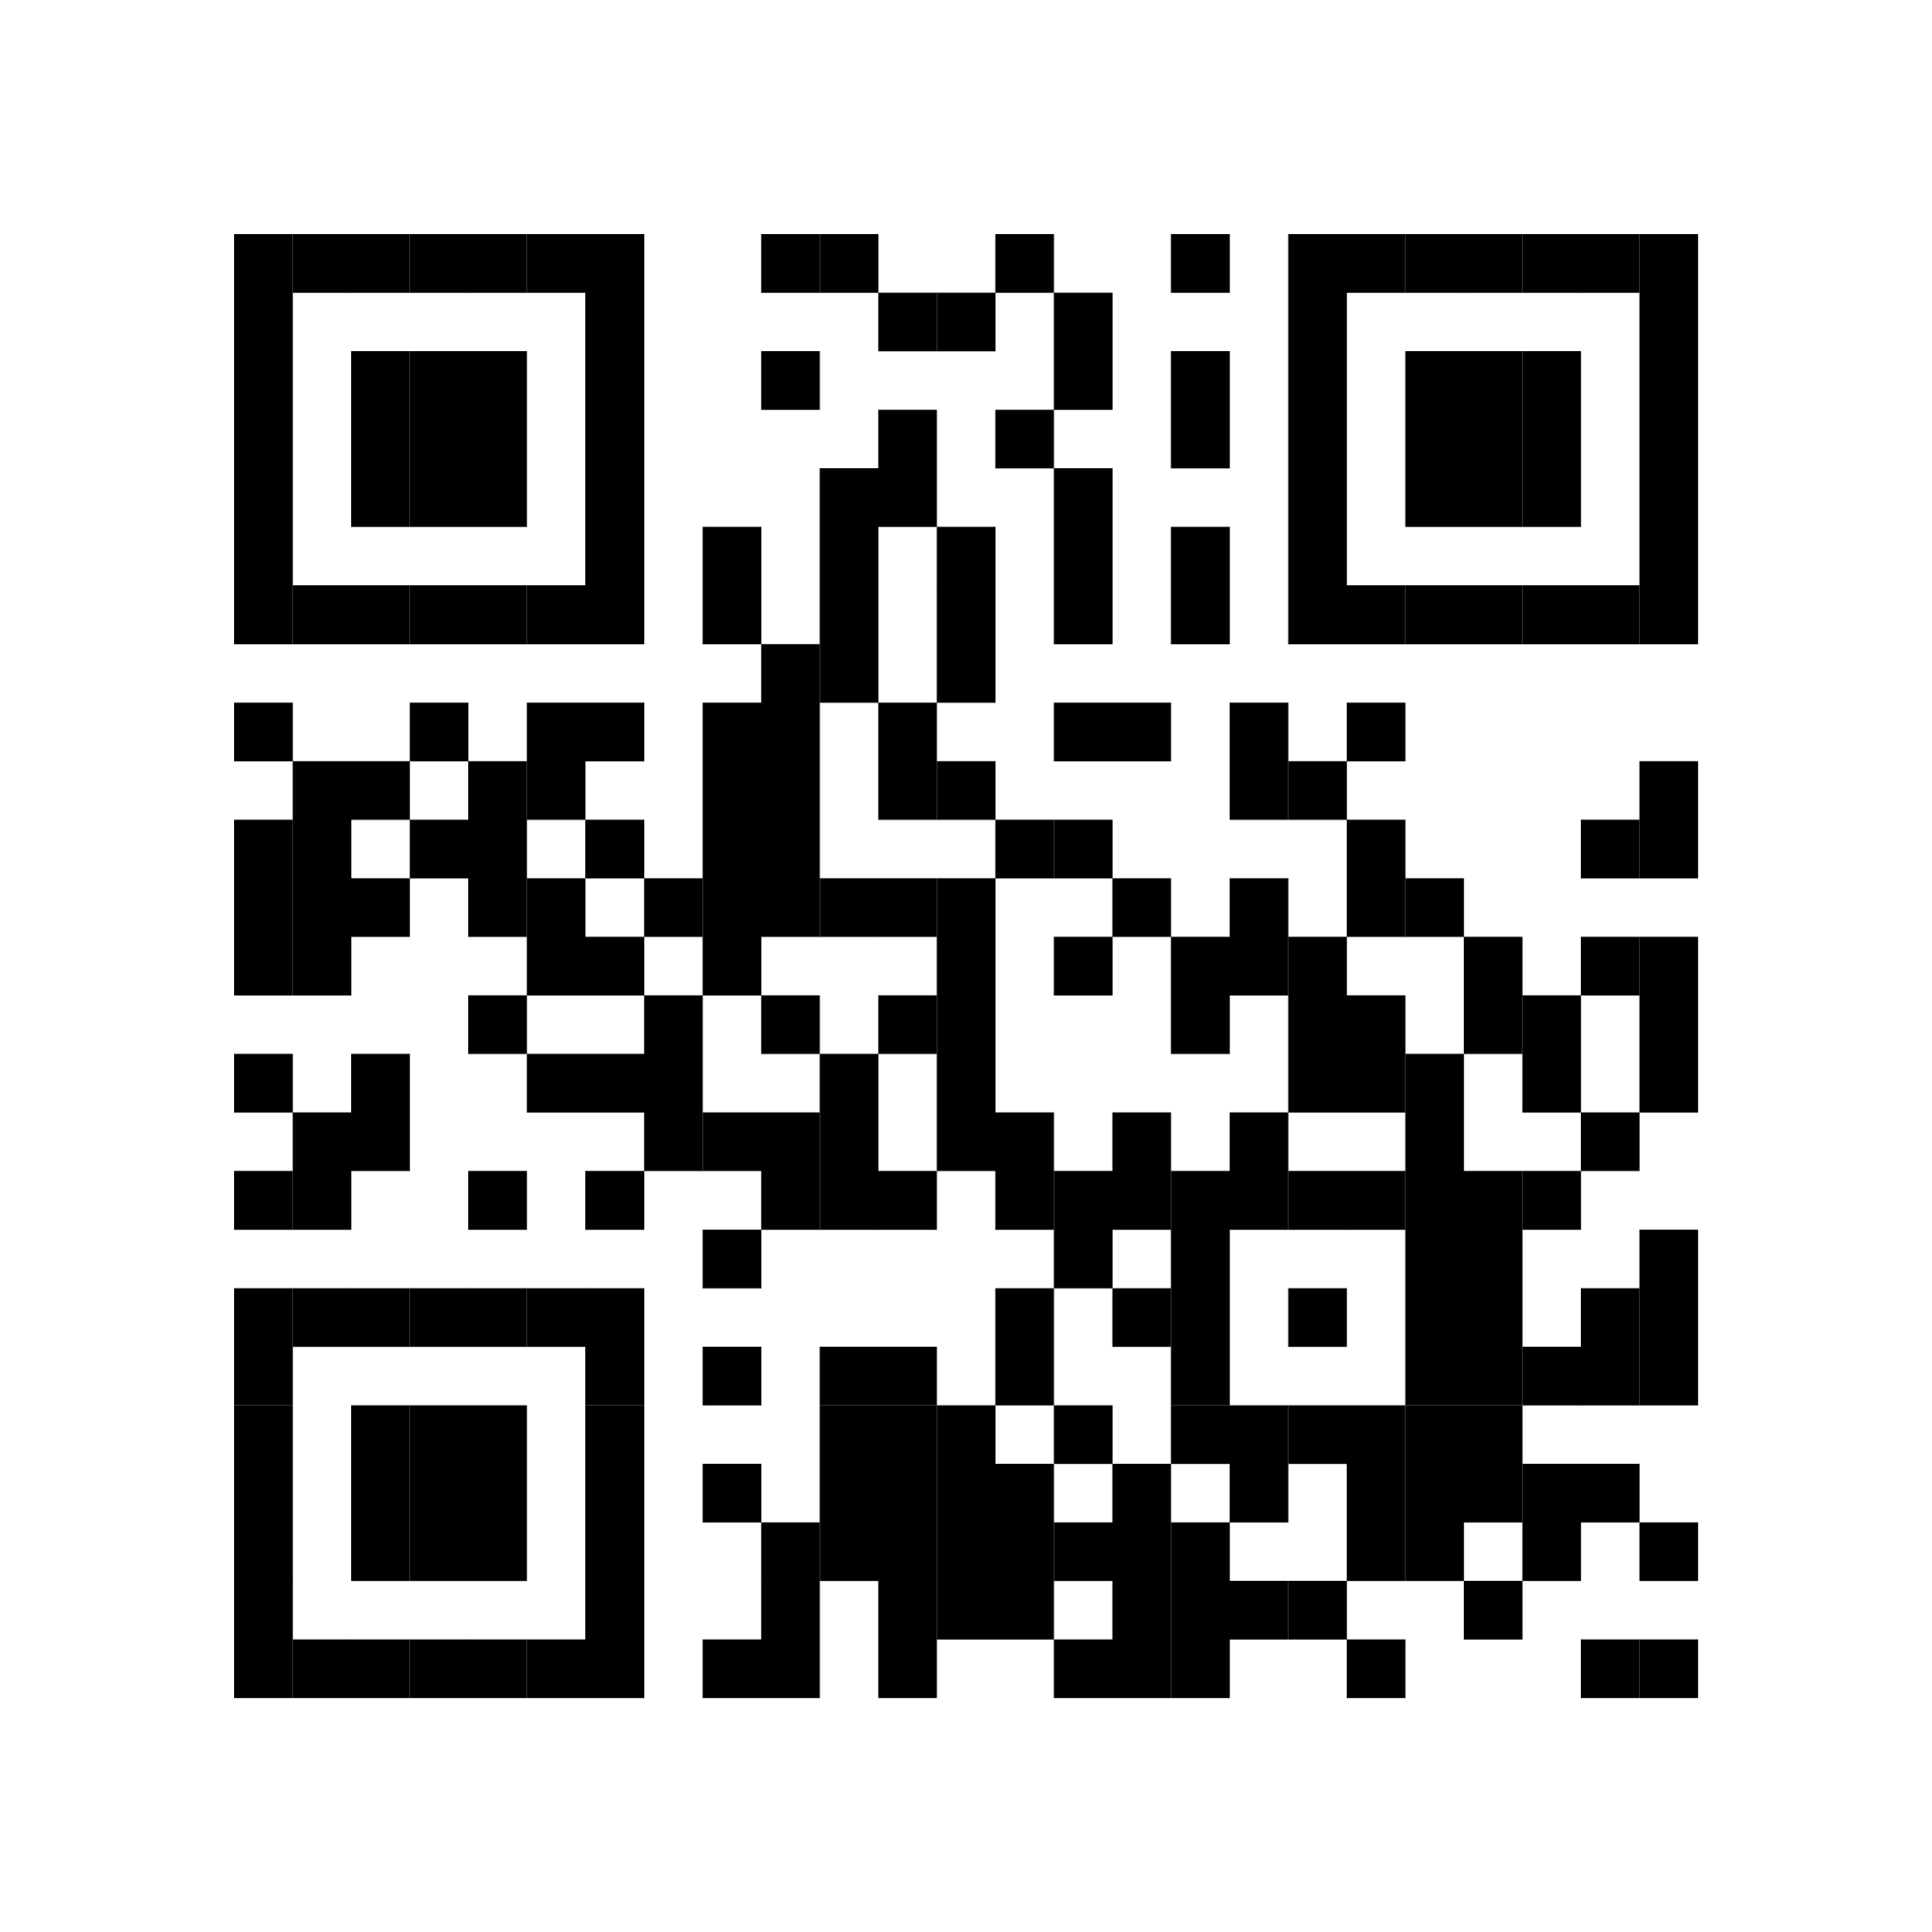
Introducing…
ESO Call Landing Page
A central location where you can find important links such as a the call’s joining link, community updates, the previous ESO slide deck, and more.
bit.ly/AR-ESO
If you have questions or concerns, please contact:
Mallory Race, Senior Project Manager
Arkansas Economic Development Commission
Mallory.Race@ArkansasEDC.com

Slide 5
New Member Introductions

Slide 6


Slide 7
Program Updates

Slide 8

ESO Monthly Report Out
10/1/2025

Slide 9
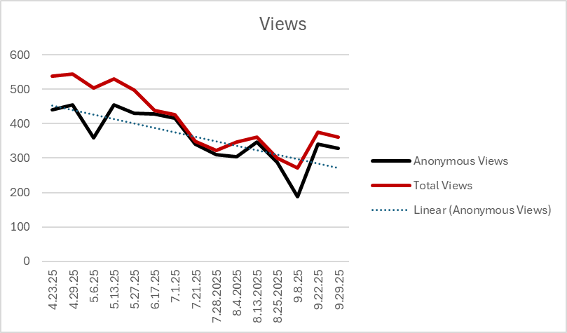

Slide 10
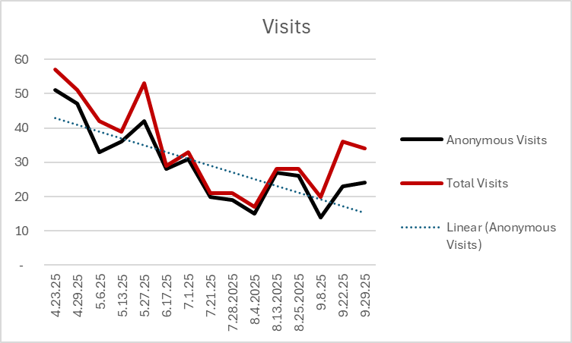

Slide 11
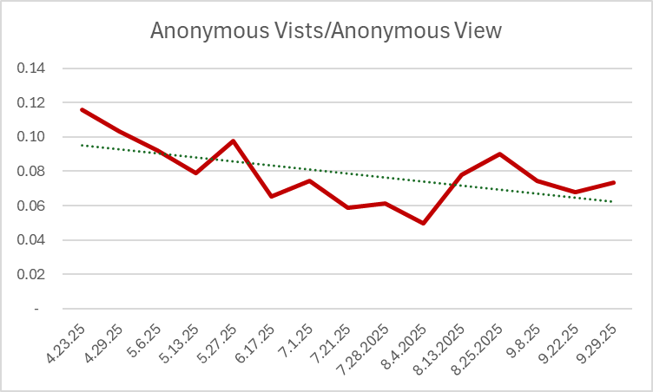

Slide 12
314
265
49
Total Visitors
New Visitors
Repeat Visitors

Slide 13


Hub MVPs of the Month
Resource
Organization

Slide 14


Slide 15
Personas
Early-Stage Maker (Need: Basic Legitimacy)
You’ve been selling handmade jewelry at pop-up markets in Little Rock and now want to form an LLC and open an online store. You’re not sure where to start and don’t know the difference between licenses, permits, and legal structures.
Rural Restaurateur (Need: Financing & Guidance)
You run a food truck in Mountain Home and dream of opening a small brick-and-mortar restaurant. You’ve heard about small business loans but aren’t sure what you qualify for. You don’t know who in your region could help you figure this out.
Tech Founder (Need: Customers & Mentors)
You’re a UCA grad who just built an app for scheduling mobile car washes. You’ve tested with friends but don’t know how to find early adopters, funding, or mentorship. You’re not even sure what kind of support you should be looking for.
Growth-Stage Manufacturer (Need: Workforce & Incentives)
You own a small steel fabrication shop in Fort Smith with 20 employees and have just landed a large contract. You need to hire skilled workers fast and want to know if Arkansas offers incentives for companies that are expanding.
Retail Dreamer (Need: Validation & Confidence)
You live in Helena and have always wanted to open a clothing boutique, but you aren’t sure if it’s viable in your community. You’re looking for information about training, mentorship, and how to test your idea before taking a big financial leap.

Slide 16


Slide 17
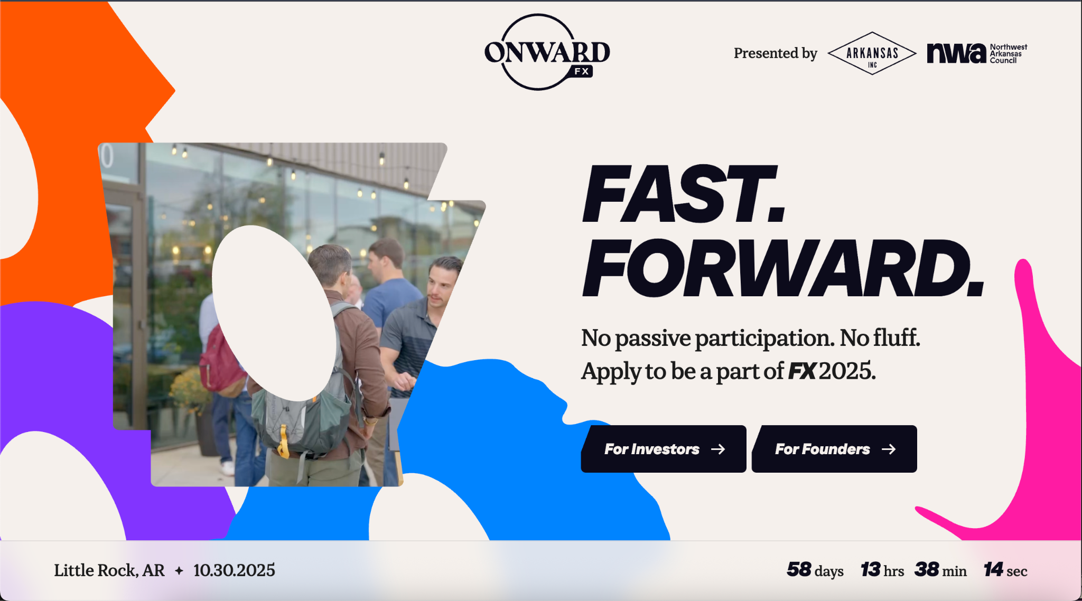

Slide 18
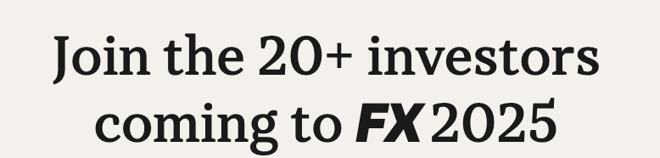
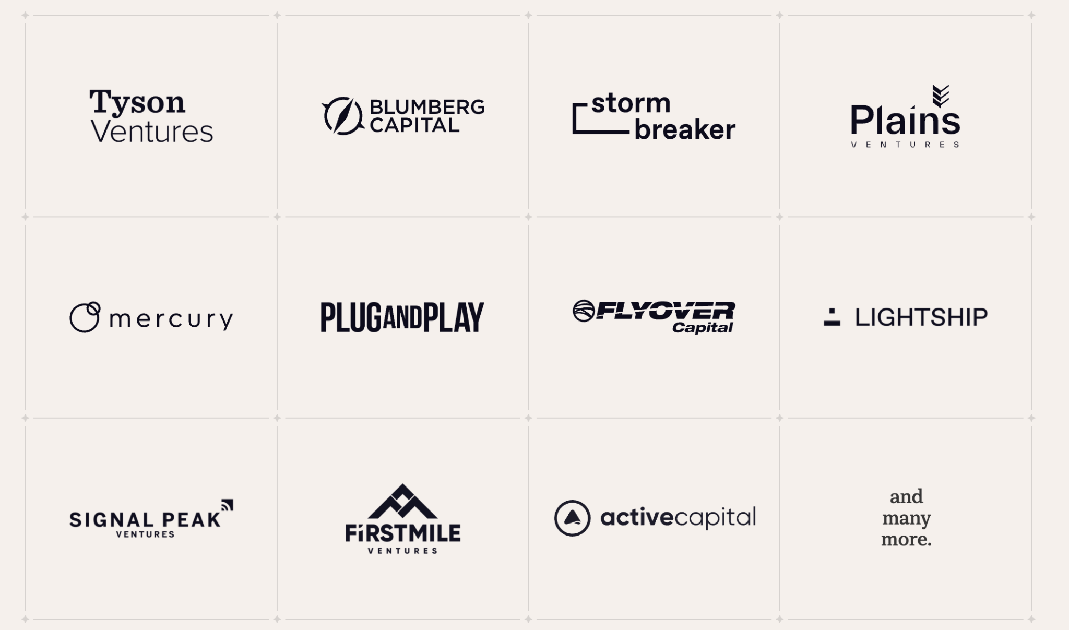

Slide 19
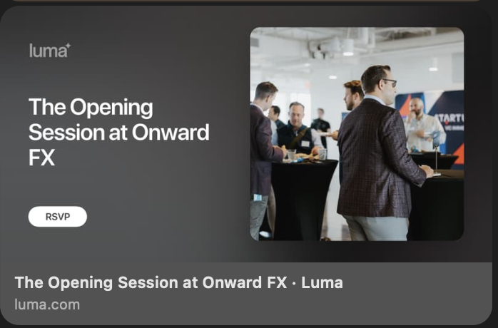
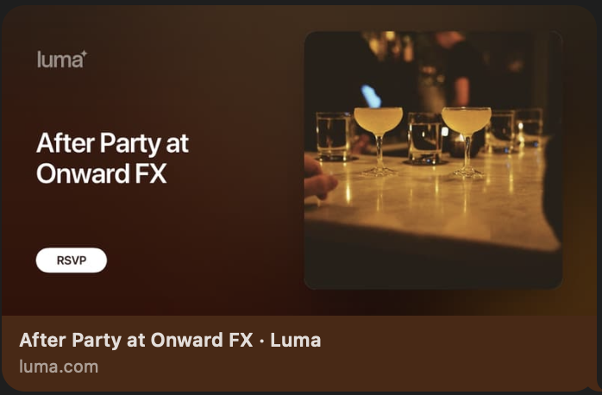
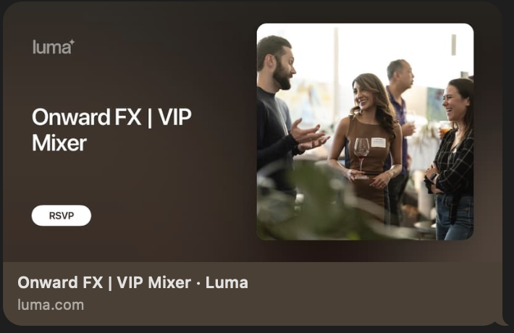
How you can get involved with FX2025

Slide 20


SEPTEMBER 2025
Community
ANNOUNCEMENTS

Slide 21


Slide 22
Thank you for joining us!
See you next month!
Next meeting will be held November 5th at 10 CT

