Slide 1

Welcome to the ESO Call!
10am -11am CT
First Wednesday of Each Month

Slide 2
February ESO Call Agenda
I. Welcome
II. New Member Introductions
Please introduce yourself and let us know how we can connect with you.
III. Entrepreneurial Spotlight
Bryan Fittin, Founder and CEO of Go Rogue Studio
IV. Community Announcements

Slide 3
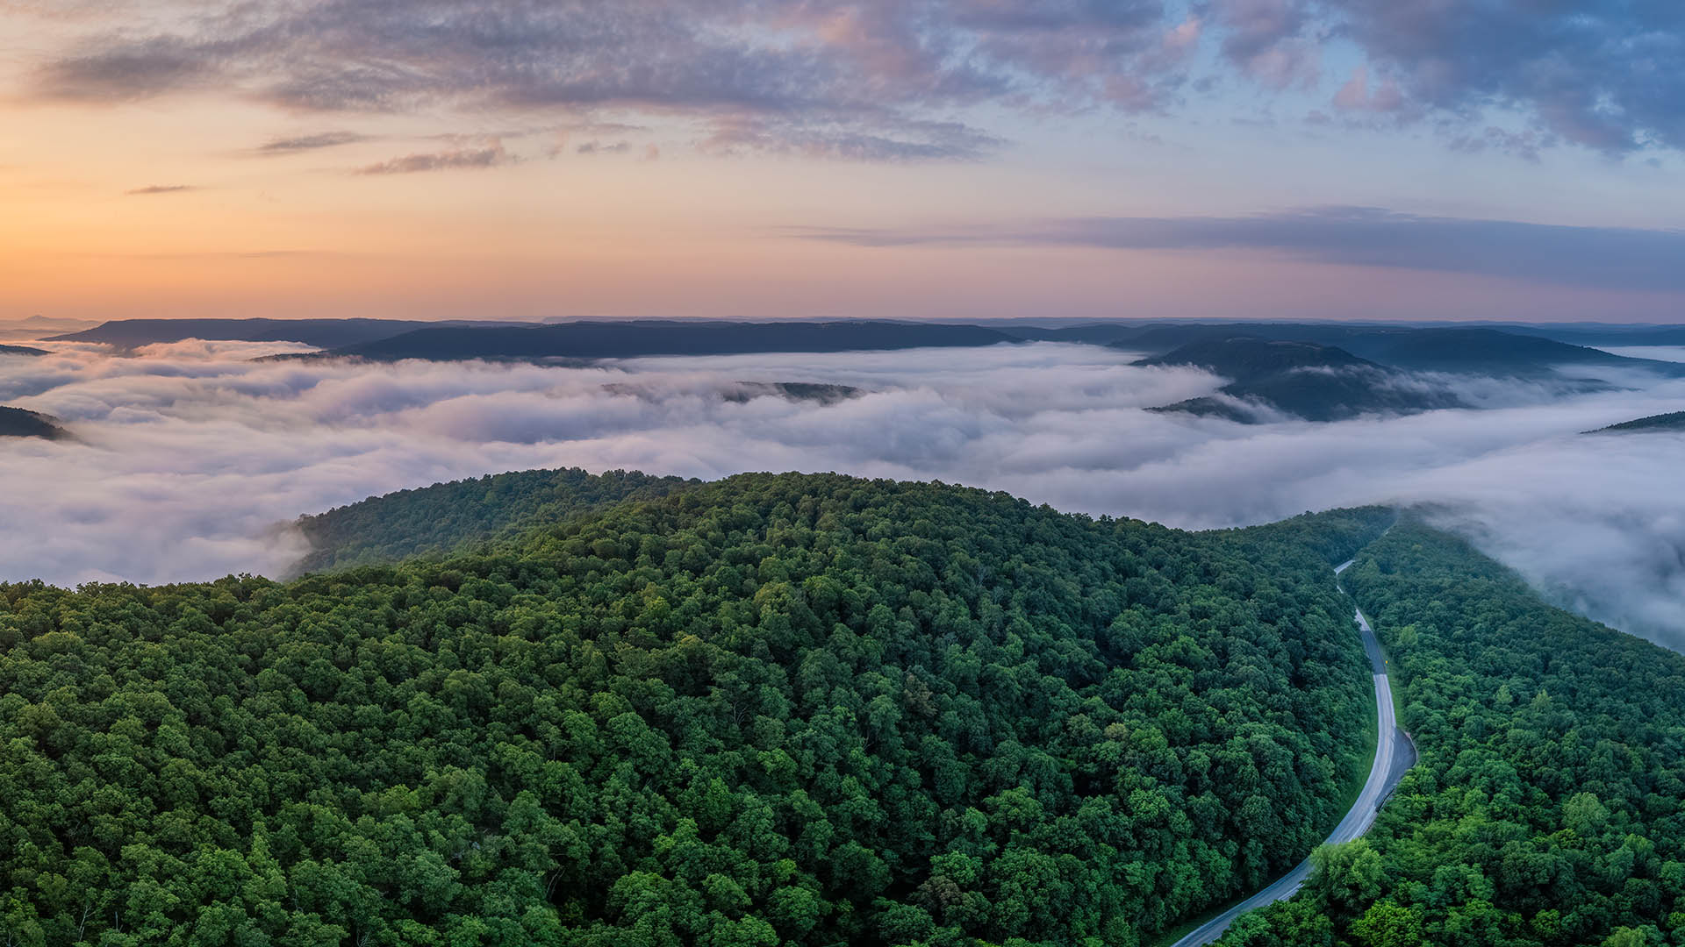




Considerations
We begin promptly at
10am CT on the ﬁrst Wednesday of each month. Calls are limited to one hour.
Meetings are recorded and will be made available upon request.
Please mute your microphones unless speaking.
If you have an announcement, please make sure you send it in our announcement link on our website.

Slide 4

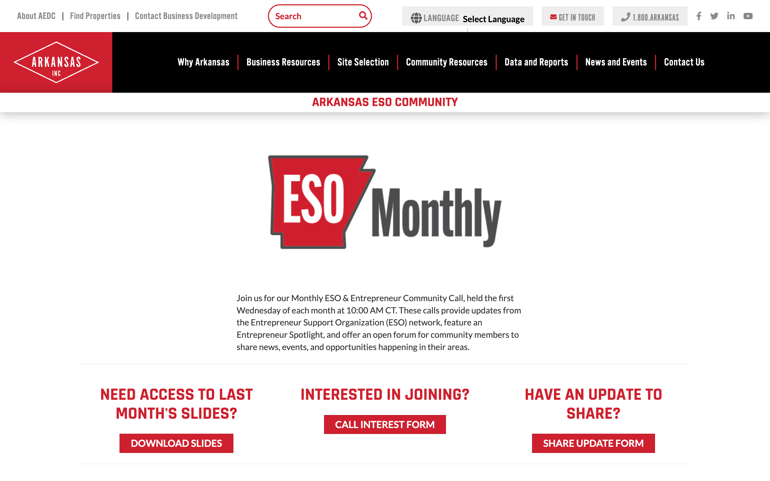
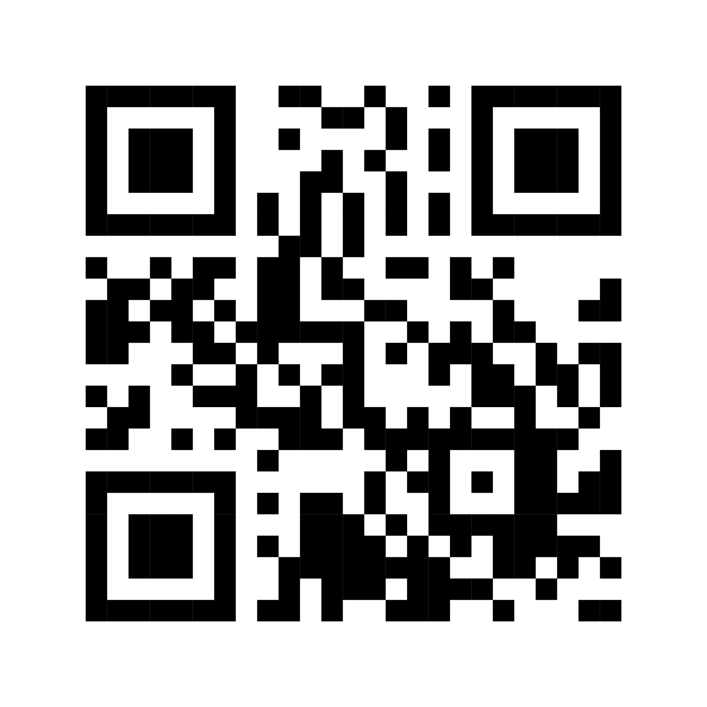
ESO Call Landing Page
A central location where you can find important links such as the call’s joining link, community updates, the previous ESO slide deck, and more.
If you have questions or concerns, please contact:
Mallory Race, Senior Project Manager
Arkansas Economic Development Commission
Mallory.Race@ArkansasEDC.com
bit.ly/AR-ESO

Slide 5
New Member Introductions

Slide 6




Slide 7
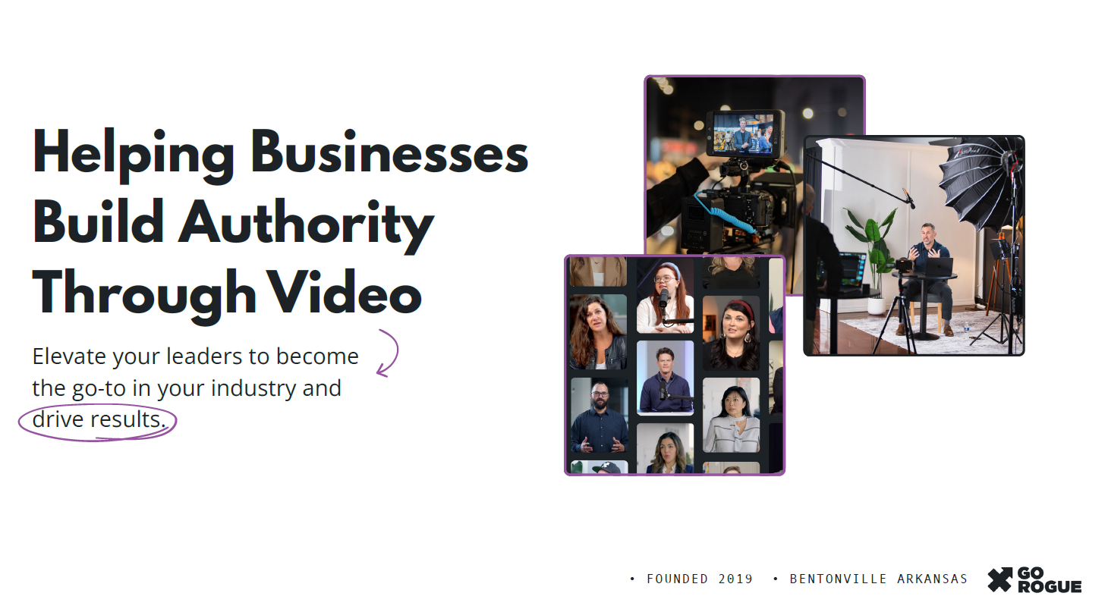

Slide 8
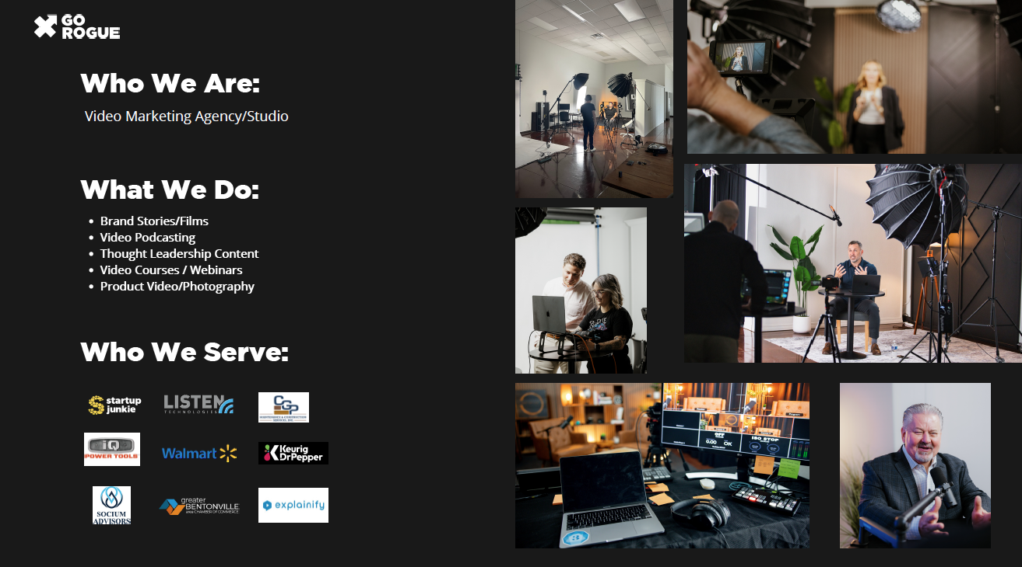

Slide 9
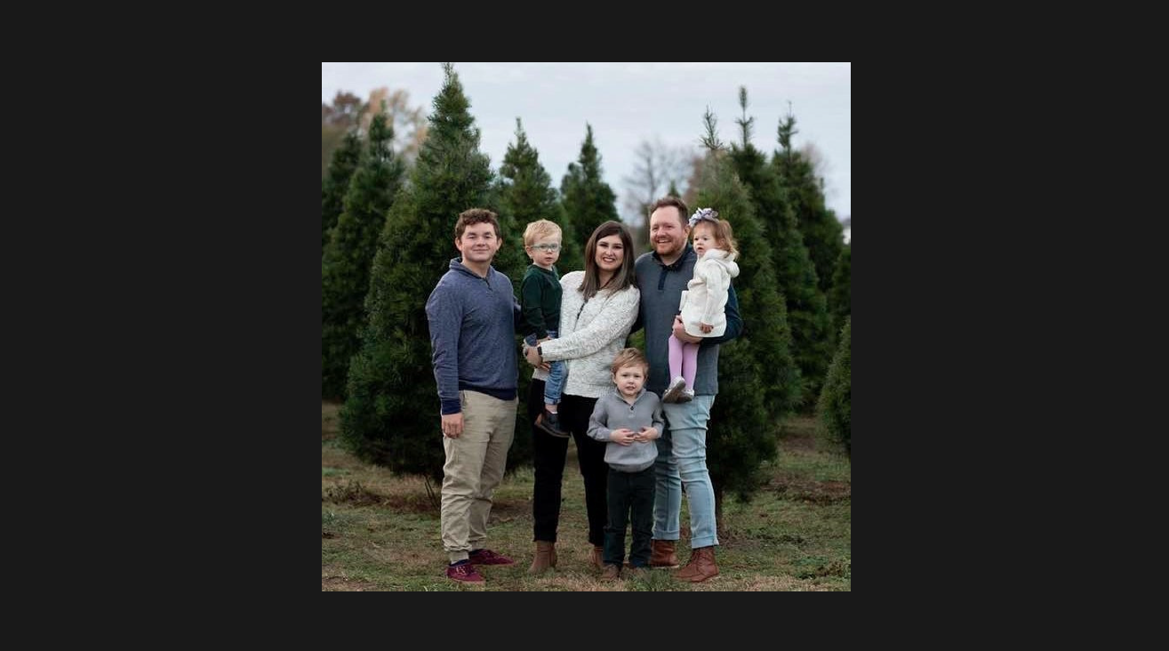

Slide 10
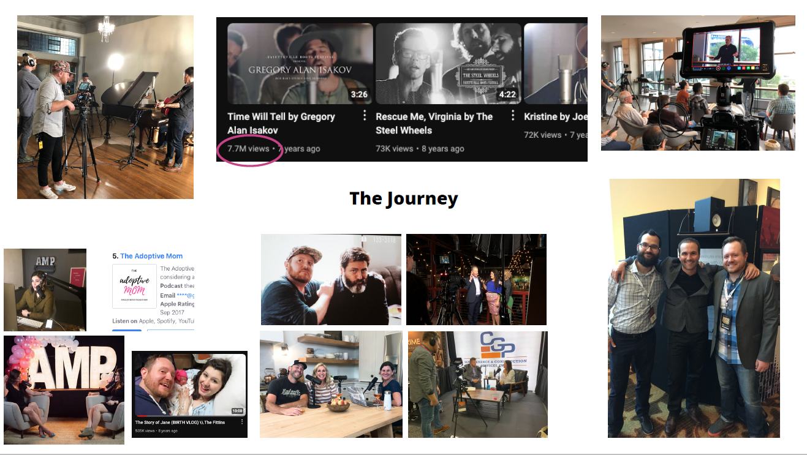

Slide 11


Slide 12
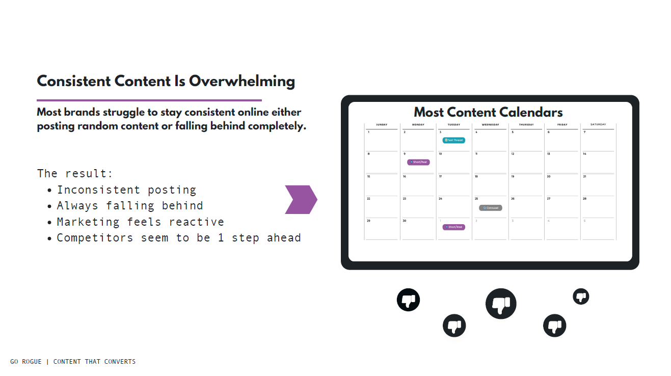

Slide 13
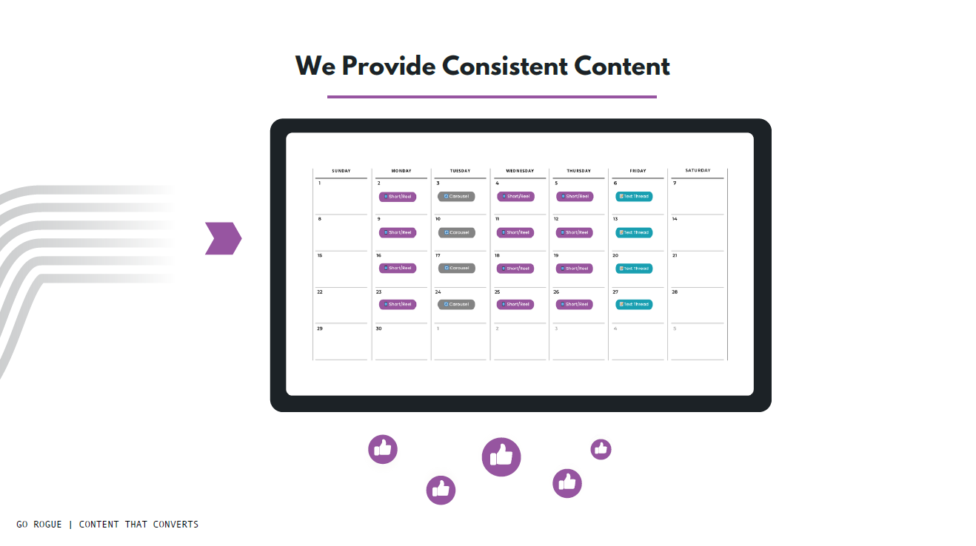

Slide 14
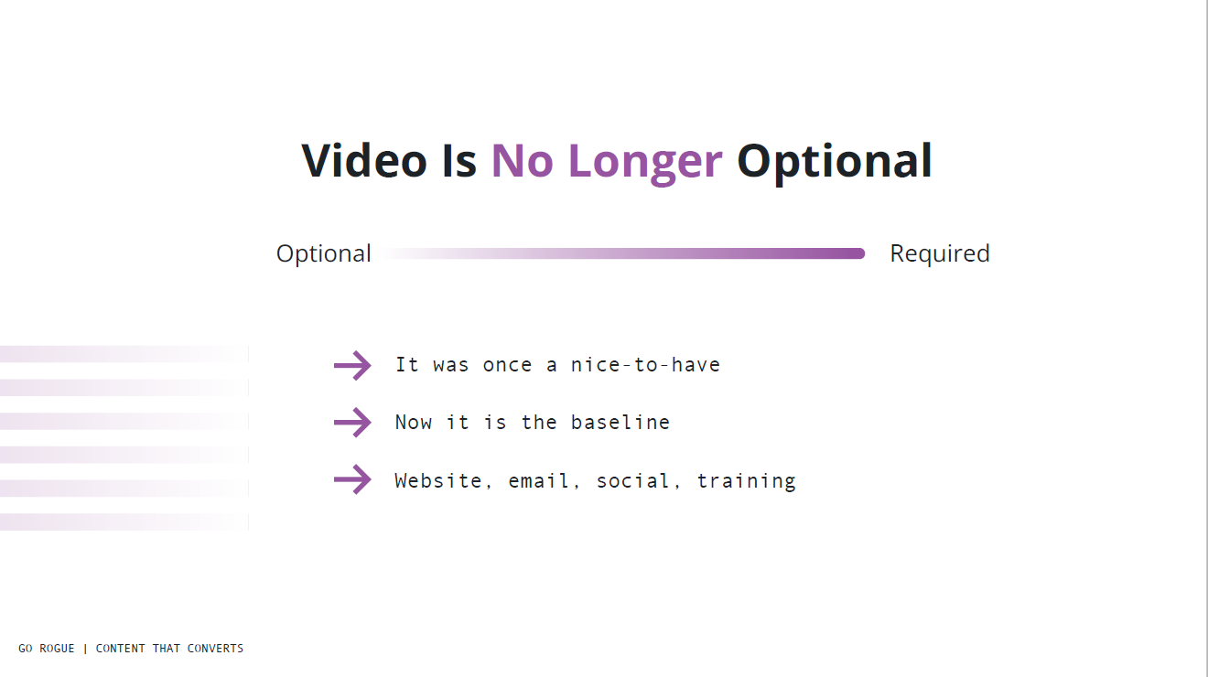

Slide 15
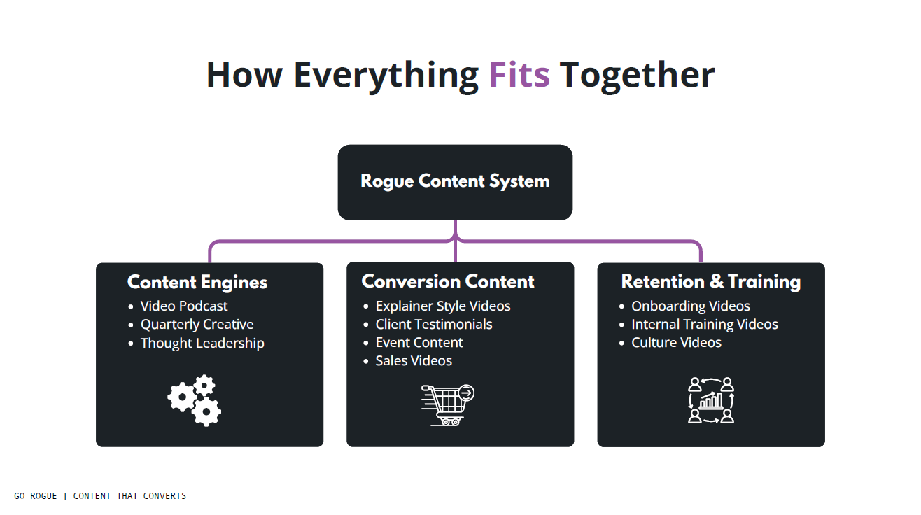

Slide 16
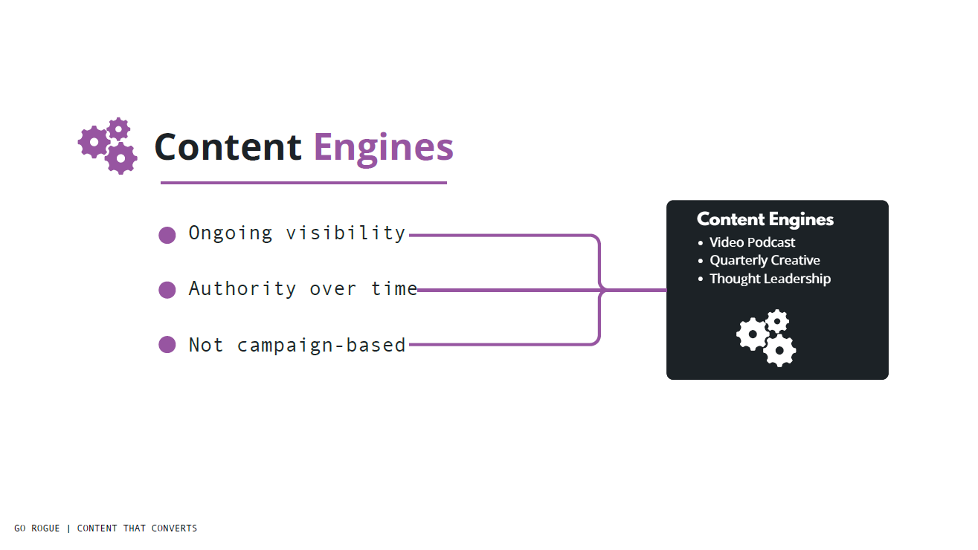

Slide 17
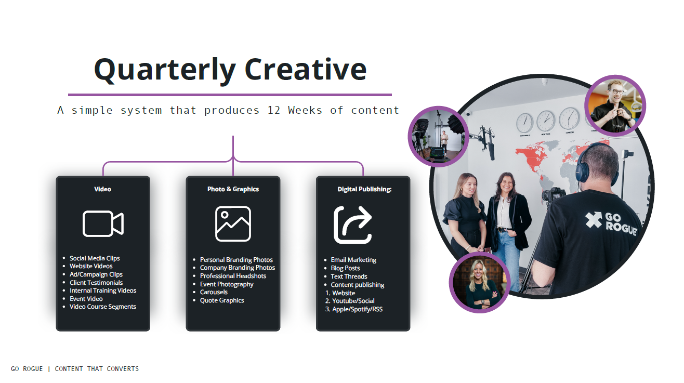

Slide 18
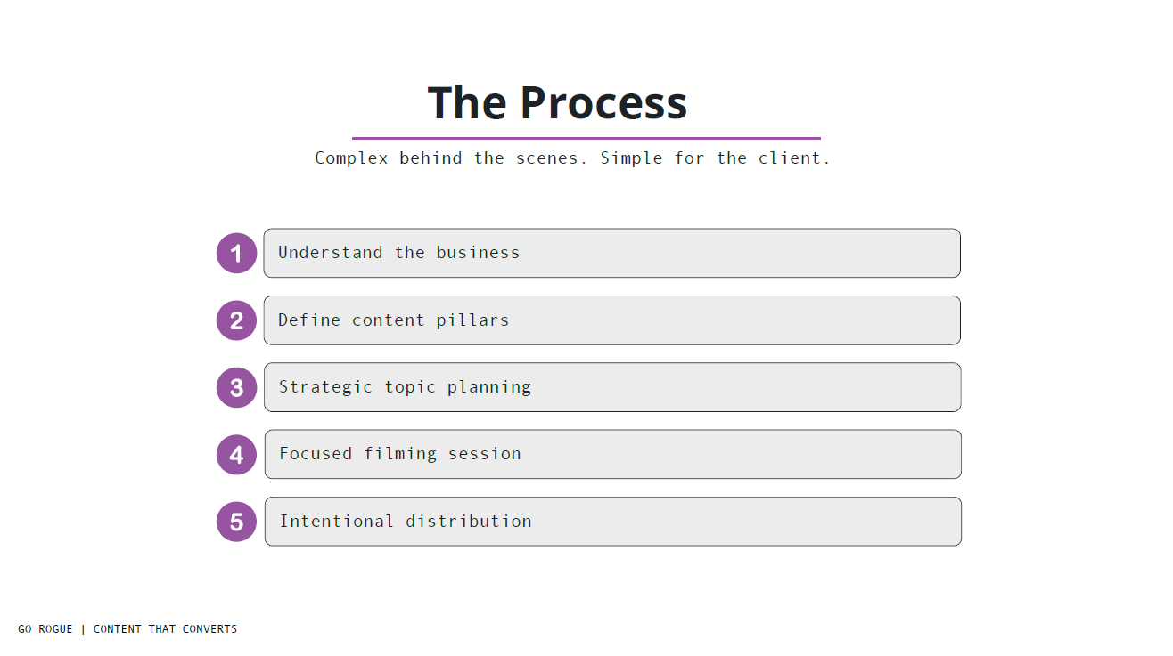

Slide 19
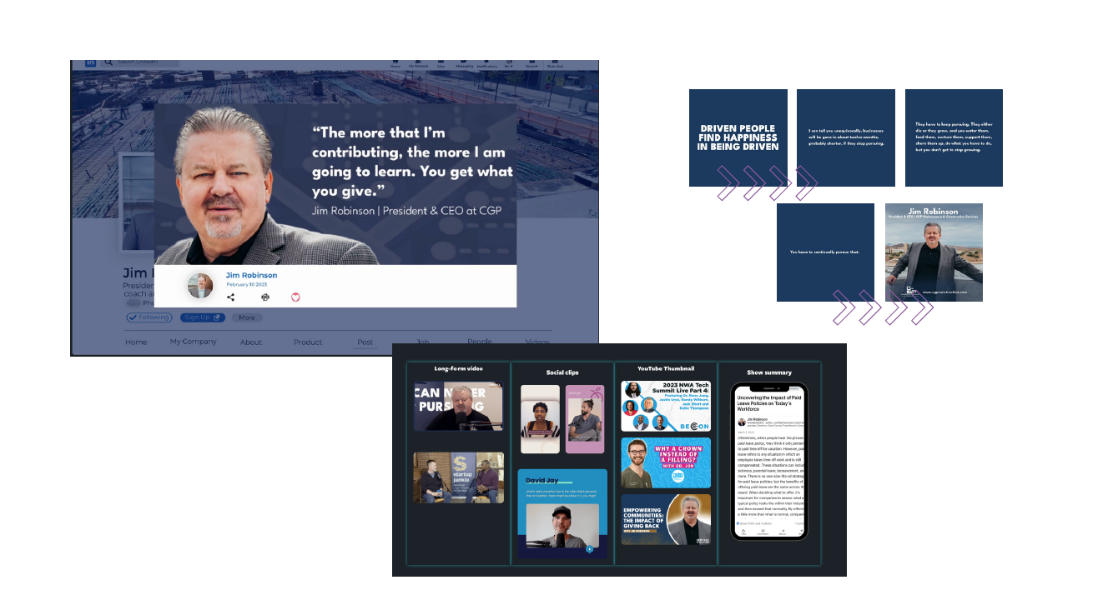

Slide 20
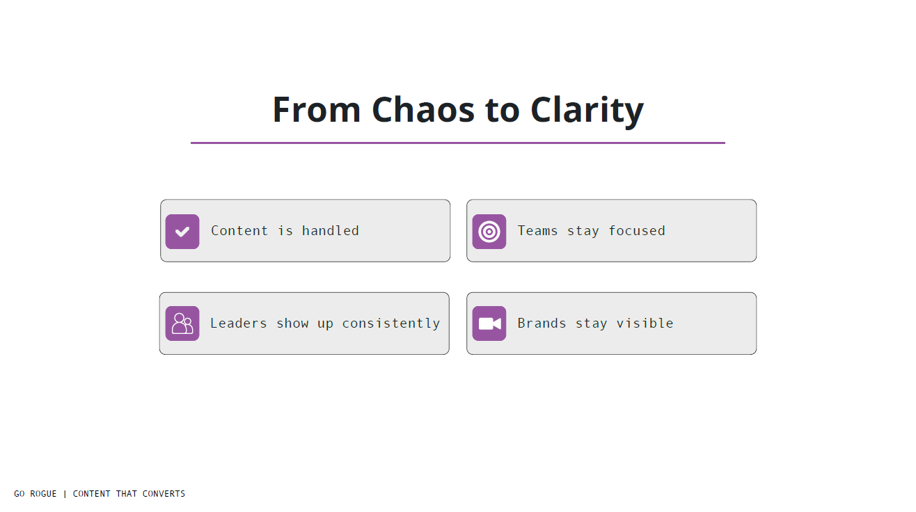

Slide 21
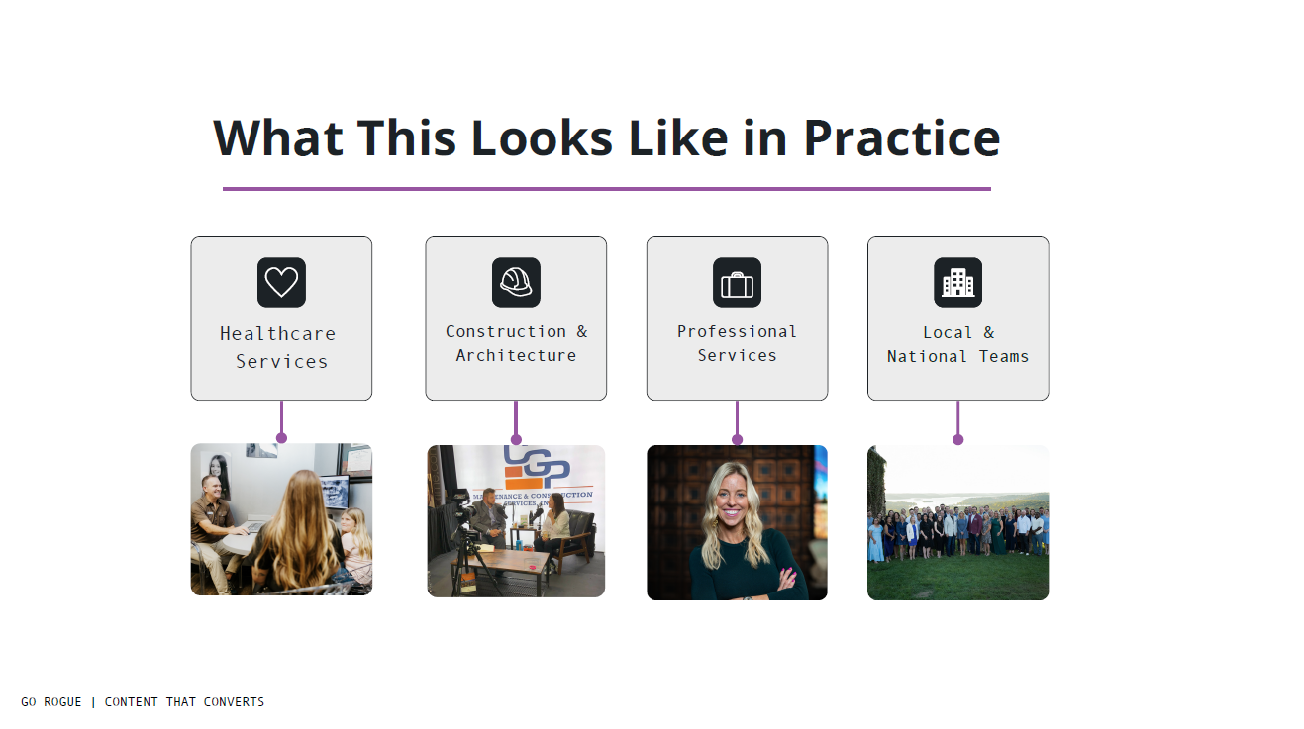

Slide 22
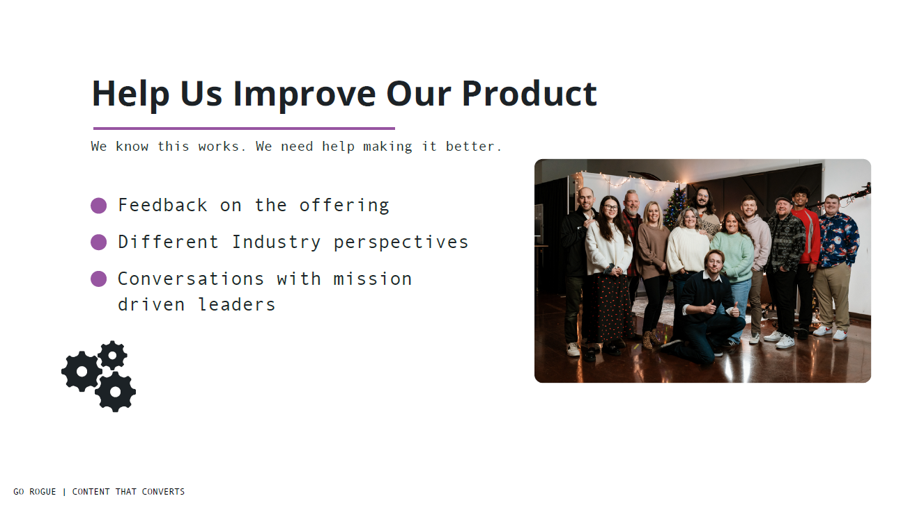

Slide 23
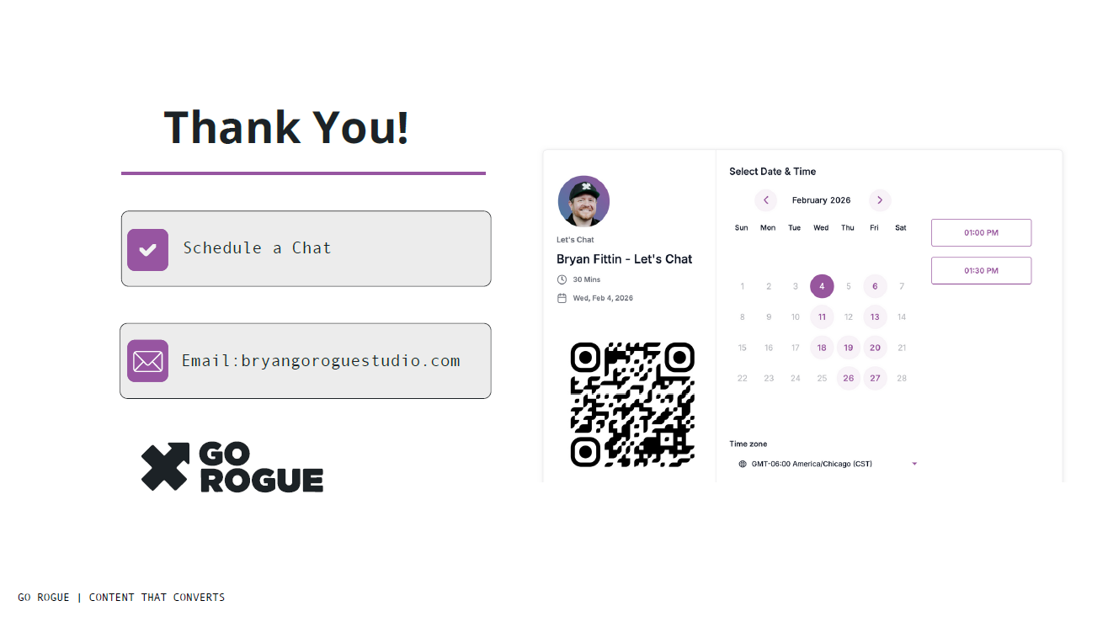

Slide 24


February 2026
Community
ANNOUNCEMENTS

Slide 25



Slide 26

Event Link: https://web.cvent.com/event/eeb3b0fd-fdc1-48d5-91b2-64693d39153b/websitePage:98e4e60a-76ec-4076-9291-d795e9a3edef?fbclid=IwY2xjawPwpfVleHRuA2FlbQIxMABicmlkETFWQlRXTUdoNkxhN1d1MzJyc3J0YwZhcHBfaWQQMjIyMDM5MTc4ODIwMDg5MgABHpBfJqtZMcfQvcLw5mkk6EiQTRQwkcVfjU-8eVXkL-1WoQwrh8KGUQFX5aMi_aem_oKt279-WWlksDDgnJd8AXg

Slide 27




GORP is back….
The Greenhouse Outdoor Recreation Program (GORP) is an incubator for early-stage outdoor recreation startups. Through in-person weekly evening workshops, GORP provides the tools to confirm your business model and move quicker to launch with a better chance of success.
Companies receive:
Weekly cohort training sessions – Tuesdays (March 3-May 19)
Dedicated Mentors
Access to GORP Alumni & Community Network
Dedicated UA Internship Support
Product/Service Development Support
Up to $15,000 of non-dilutive funding
Apply by February 9: GORP.uark.edu (opens Jan 9)
Questions: Ask Windy - windye@uark.edu

Slide 28



Ozark Retail Accelerator is designed to provide Arkansas-based CPG companies practical tools for large retail operational readiness.
Over 12 weeks, founders gain hands-on access to retail operators, former buyers, and category leaders who have built, scaled and launched suppliers inside some of the largest omnichannel retailers in the world. The workshops will include buyer presentations, supply chain & packaging, retailer systems, retail media marketing, omnichannel planning and so much more.
Ideal candidates are ready for scale with the following attributes:
Consumer Packaged Goods (CPG) product
Ready to scale to Large Regional/National Retailers
Arkansas-based or Arkansas-committed
Real product in market with sales
Willing to invest the time into learning and growing
Apply by February 15: ozarkretailaccelerator.com
Questions: phils@uark.edu or info@ozarkretailaccelerator.com

Slide 29


Slide 30


Slide 31


March 2 | 9:00 AM – 1:00 PM | AFIC@MCO
  Hands-on workshop for farmers exploring value-added opportunities
  Real examples of turning farm ingredients into market-ready products
  Covers product ideation, small-scale processing, packaging, and labeling basics
  Practical insights without pressure to commit or scale immediately
  Guided tour of AFIC@MCO’s processing capabilities
Light lunch provided
Register: https://www.eventbrite.com/e/1981958445062?aff=oddtdtcreator

Slide 32


Slide 33


Slide 34

https://www.gener8tor.com/careers?gh_jid=5791132004

Slide 35



Slide 36


Slide 37
Thank you for joining us!
See you next month!
Next meeting will be held March 4th at 10 CT

