Slide 1

Welcome to the ESO Call!
10am -11am CT
First Wednesday of Each Month

Slide 2
September ESO Call Agenda
I. Welcome
II. New Member Introductions
Please introduce yourself and let us know how we can connect with you.
III. Entrepreneurial Spotlight
Serafina Lalany, Executive Director NWA Council’s Entrepreneurial Program
IV. Program Updates
V. Community Announcements

Slide 3





Considerations
We begin promptly at
10am CT on the ﬁrst Wednesday of each month. Calls are limited to one hour.
Meetings are recorded and will be made available upon request.
Please mute your microphones unless speaking.
If you have an announcement, please make sure you send it in our announcement link on our website.

Slide 4

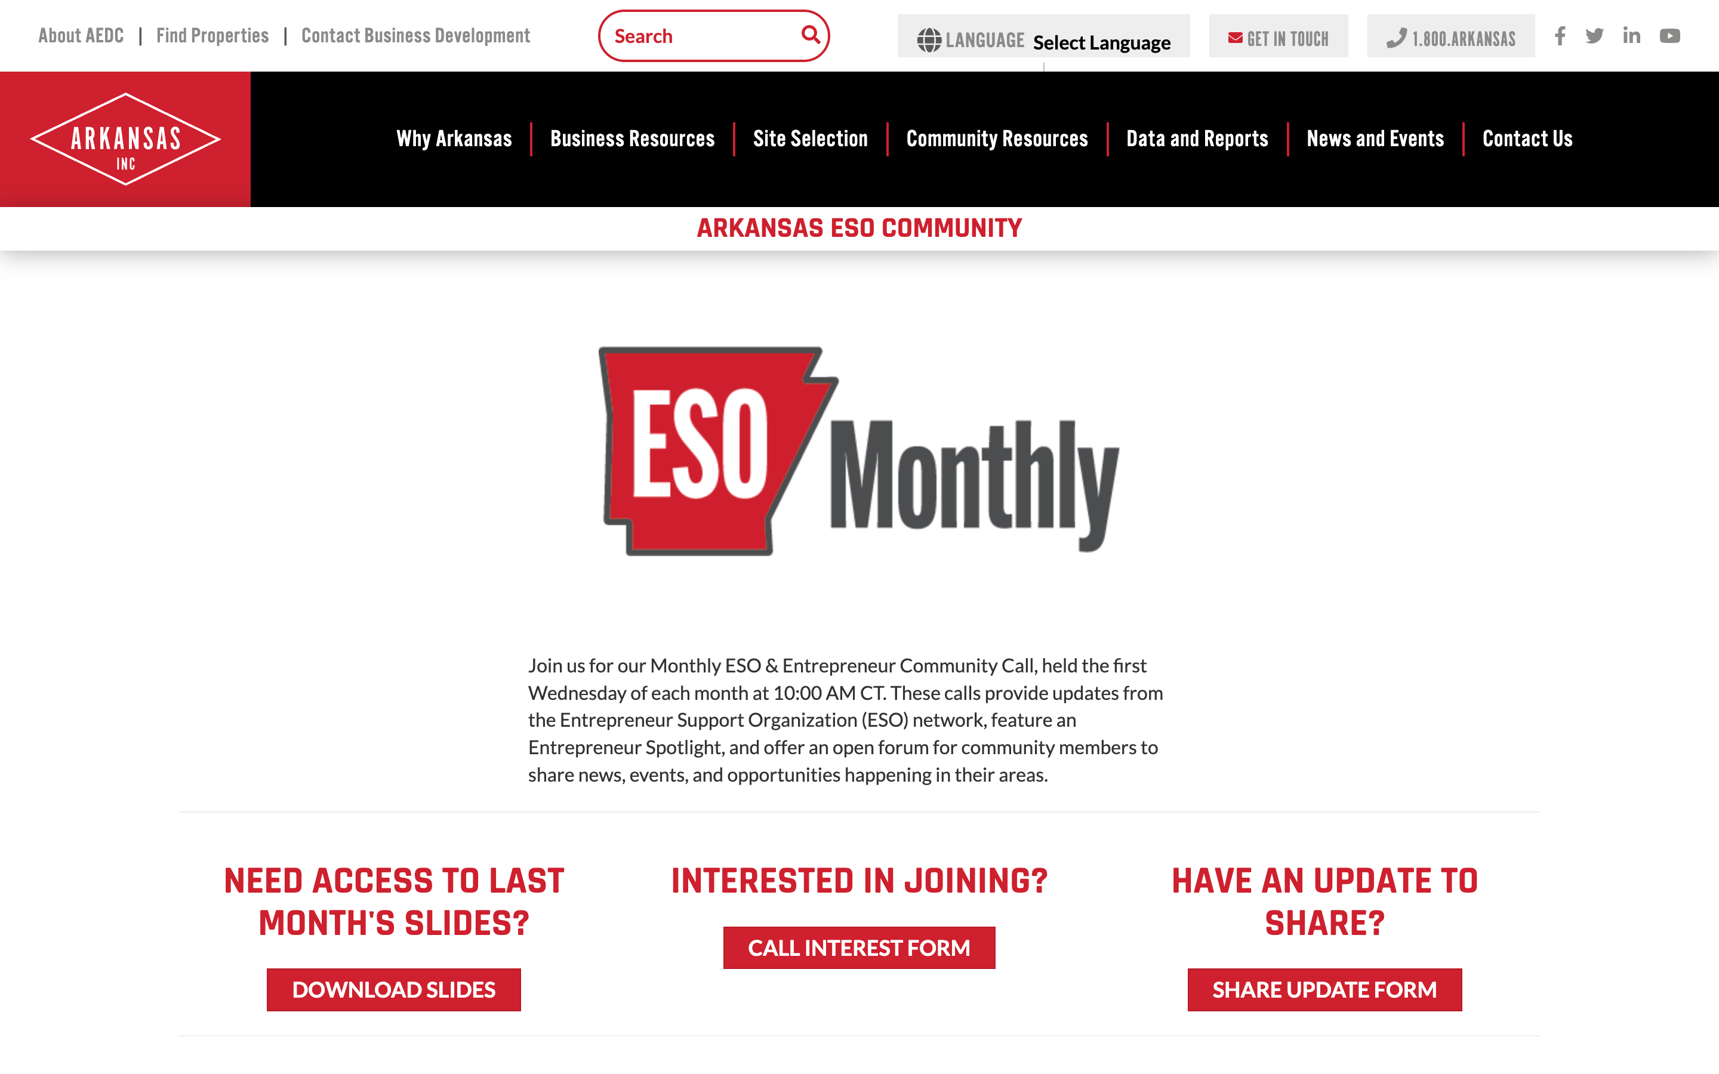
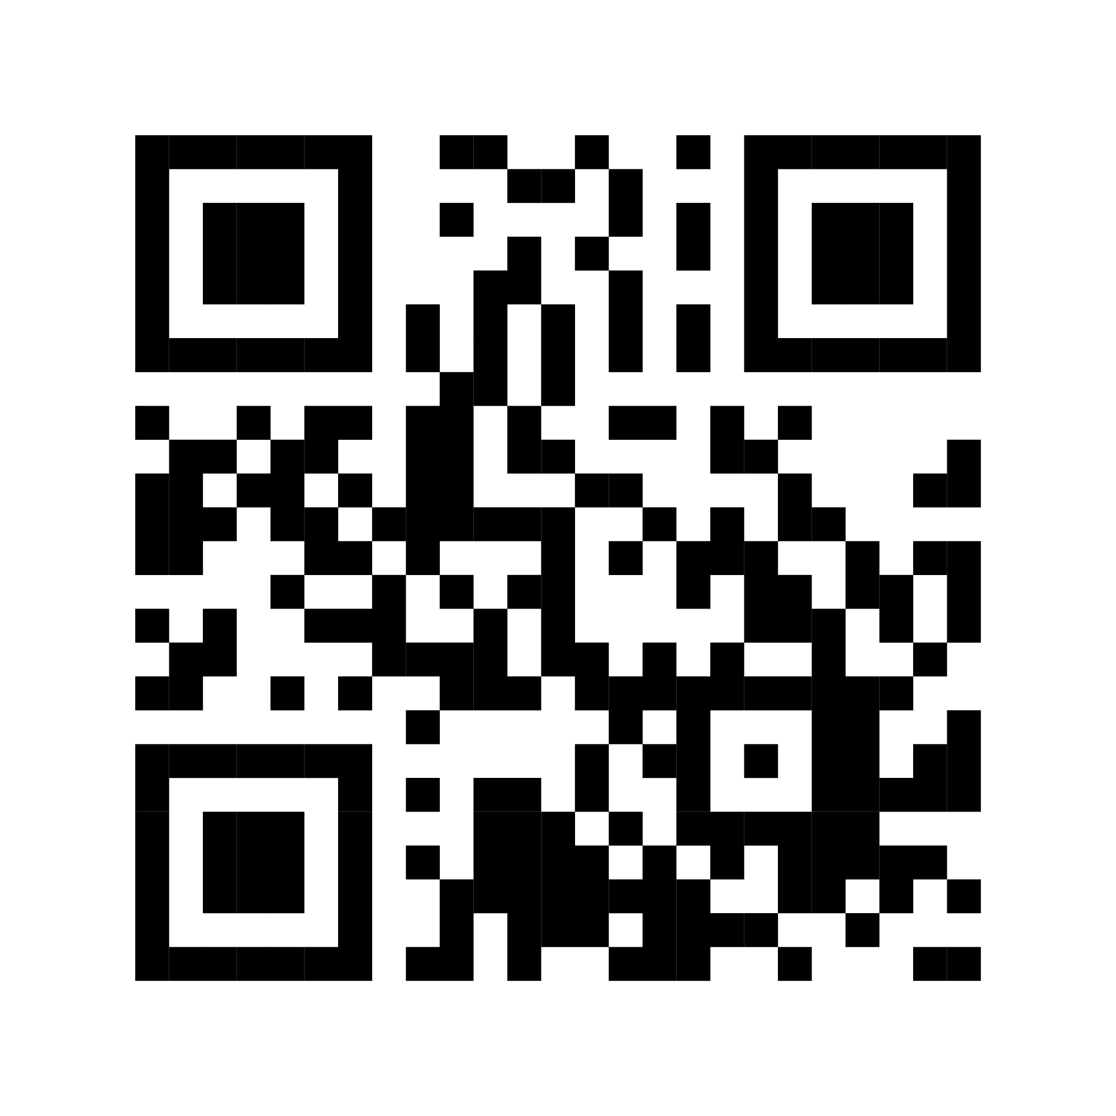
Introducing…
ESO Call Landing Page
A central location where you can find important links such as a the call’s joining link, community updates, the previous ESO slide deck, and more.
bit.ly/AR-ESO
If you have questions or concerns, please contact:
Mallory Race, Senior Project Manager
Arkansas Economic Development Commission
Mallory.Race@ArkansasEDC.com

Slide 5
New Member Introductions

Slide 6
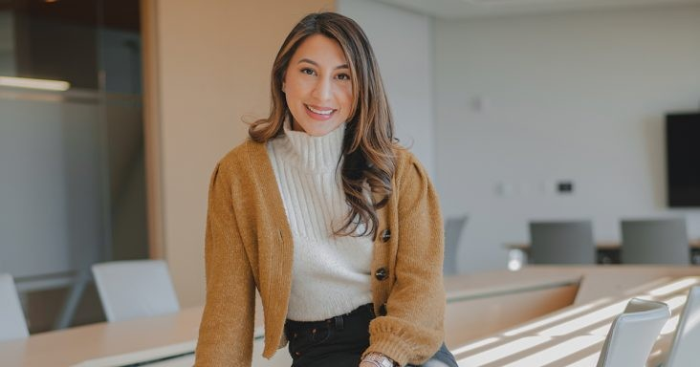
Serafina Lalany, Executive Director NWA Council’s Entrepreneurial Program

Slide 7


Slide 8
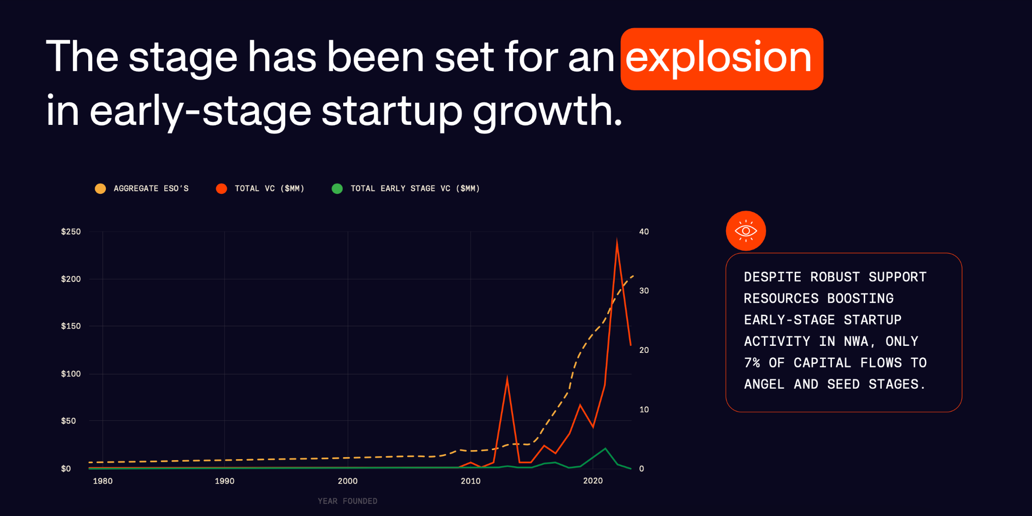

Slide 9
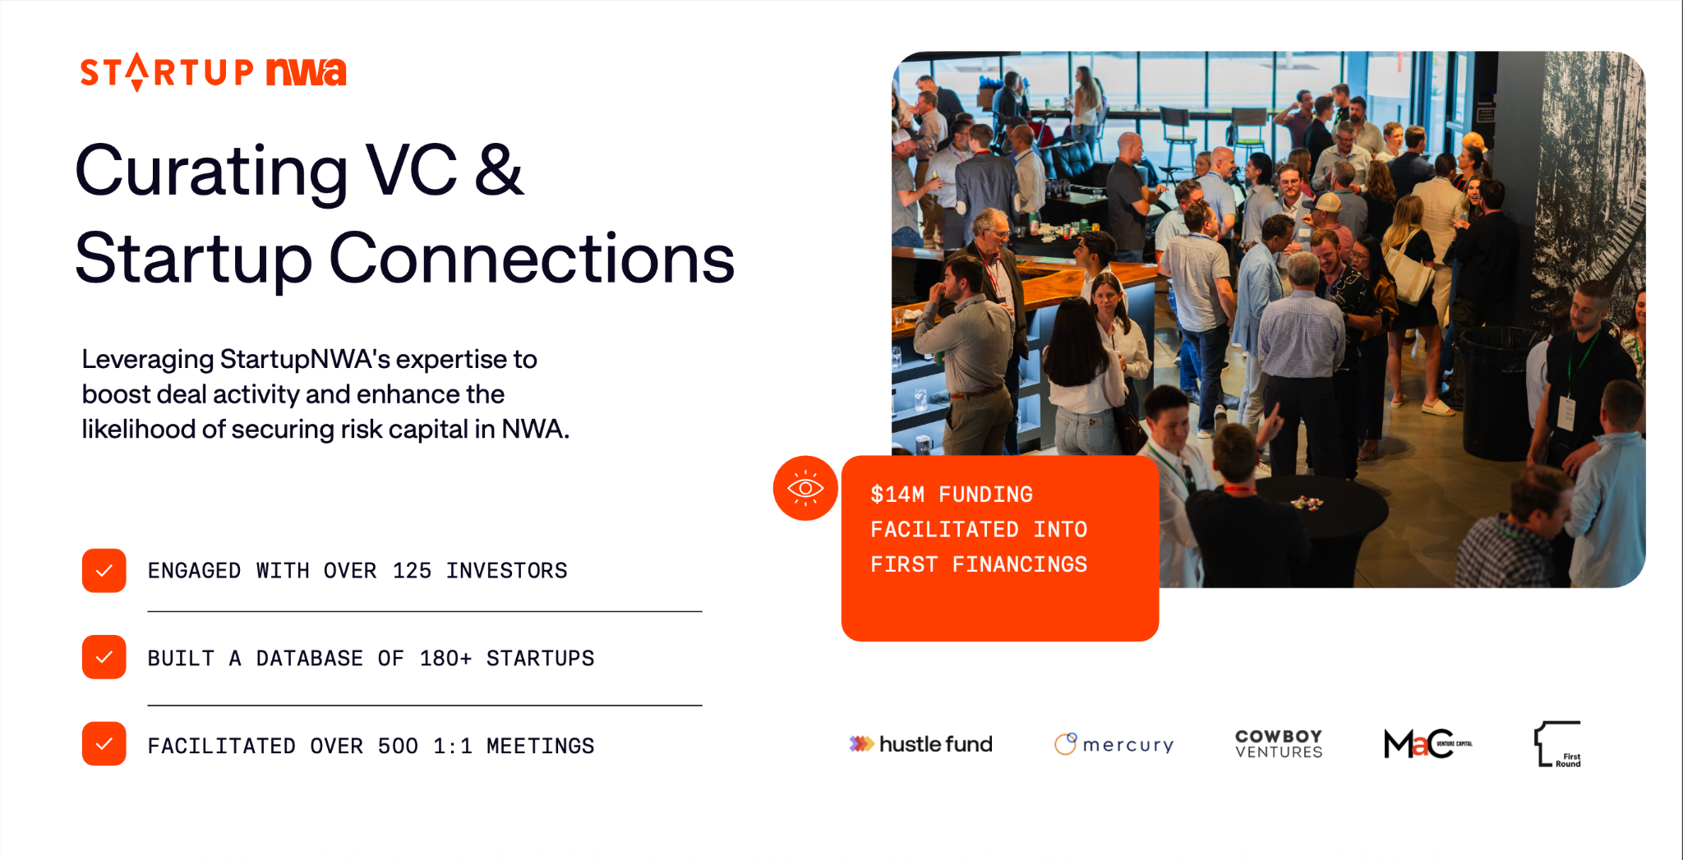

Slide 10


Slide 11


Slide 12
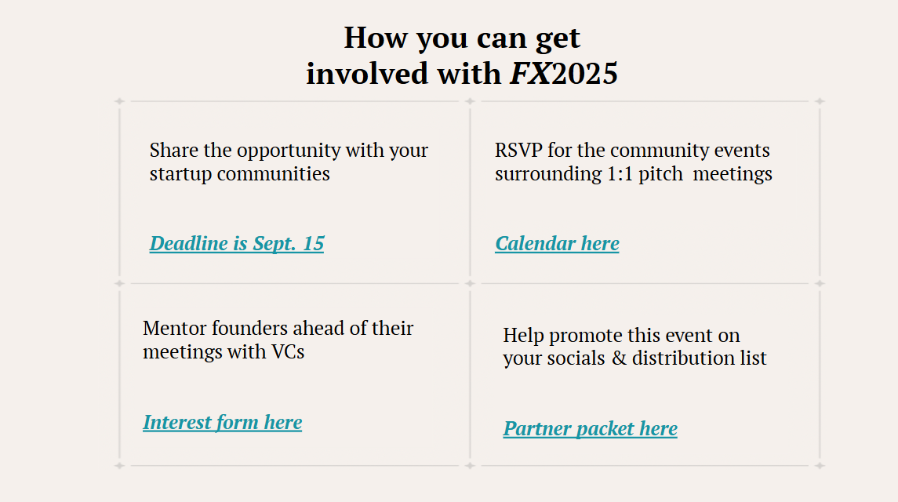

Slide 13
Program Updates

Slide 14

ESO Monthly Report Out
9/3/2025

Slide 15
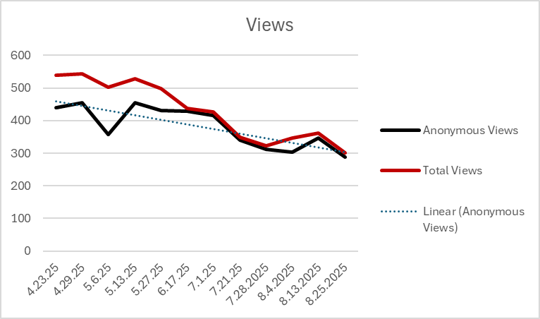

Slide 16
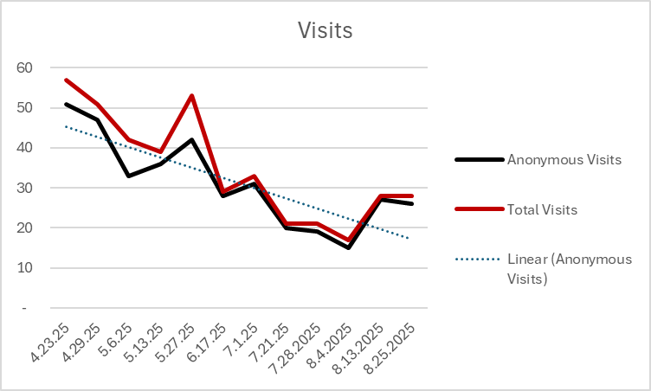

Slide 17
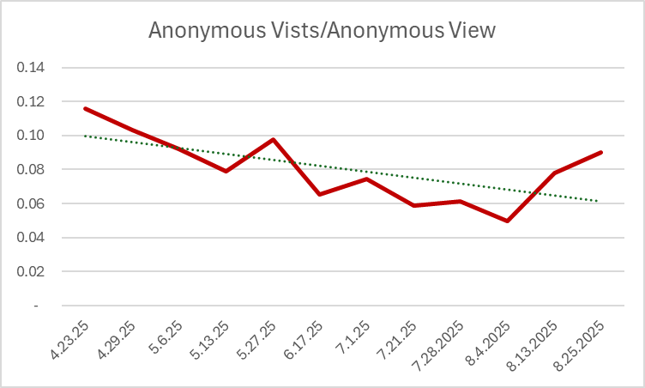

Slide 18
395
331
64
Total Visitors
New Visitors
Repeat Visitors

Slide 19


Hub MVPs of the Month
Organization
Resource

Slide 20


SEPTEMBER 2025
Community
ANNOUNCEMENTS

Slide 21


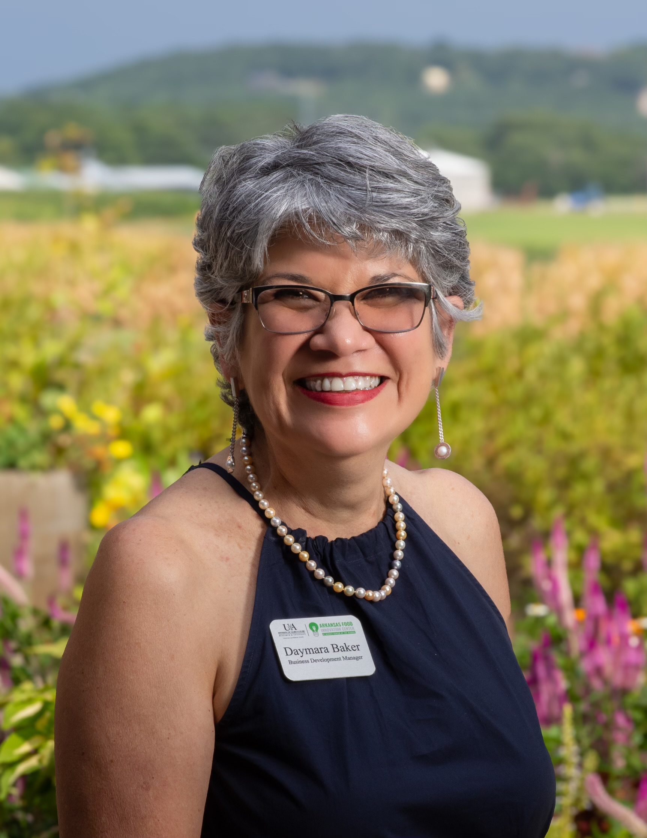
OEI ELP Session at AFIC@MCO
Organization: OEI Entrepreneurial Law Project
o When: September 12, 12 – 2:45 pm (~ 10 slots available)
o Who: targeting AFIC@MCO tenants, clients & cohort participants, SCFH farmers
o To Register: Entrepreneurial Law Checkup
(https://airtable.com/appkQTqgvm8WdBmdi/shrZiLFNdqSVJYlnF)
  daymarab@uada.edu
  AFICMCO@uada.edu
  479-575-6611
http://aficmco.uada.edu
Daymara Baker
Business
Dev. Manager

Slide 22

AFIC@MCO Is a One-Stop Solution to Small Food Businesses Providing Support to Bring Their Products to Market
Affordable Shared Commercial Kitchen
Hourly Commercial Kitchen and Bakery Room Rental
Training on professional-grade equipment
Overnight Food Truck Parking with electricity
Dry, Refrigerated, & Frozen Storage
Contract Processing
Low-volume and pilot batch runs
Onsite Expertise and Food Safety Support
Food Safety training, R&D and technical support
Nutrition labels, product testing and regulatory advice
Business development and marketing
FDA and USDA compliance support
Customizable packaging solutions
Quality assurance and R&D support

Slide 23


Slide 24


Slide 25
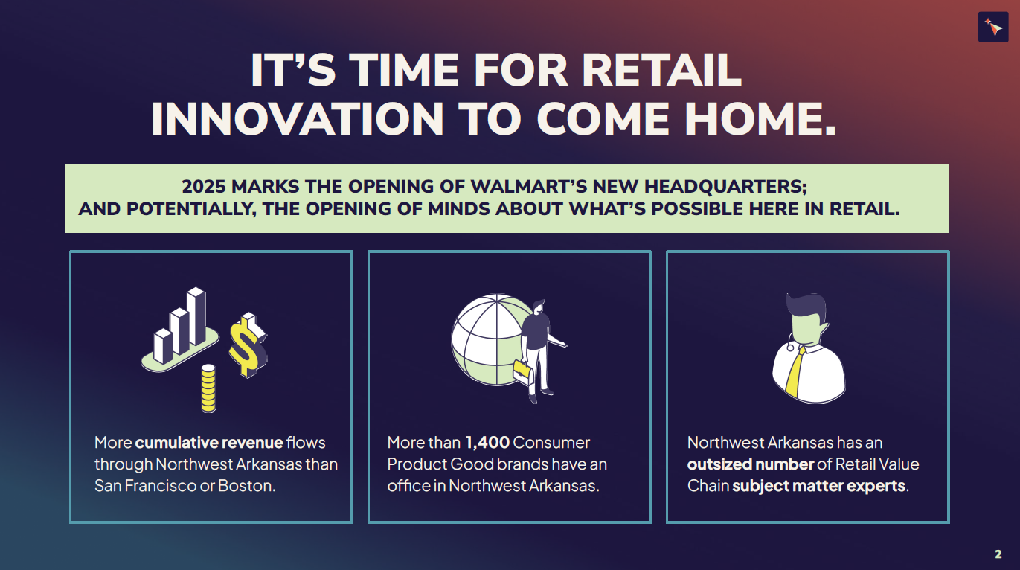

Slide 26
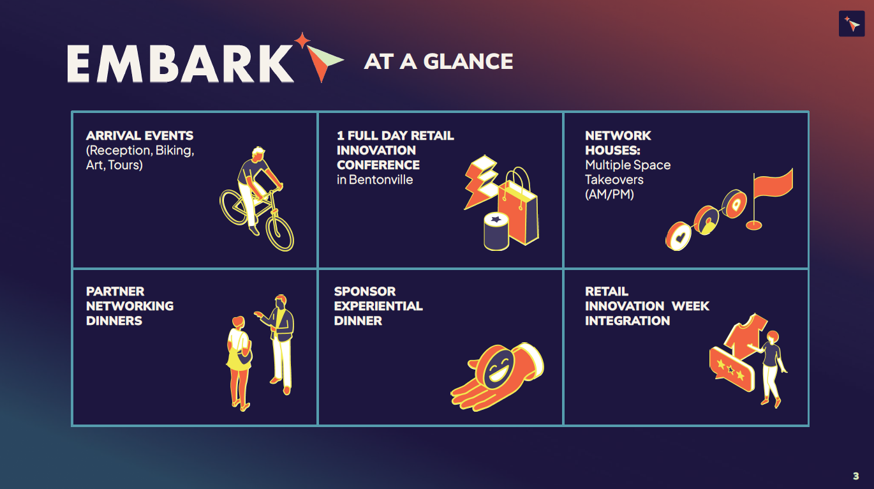

Slide 27


Slide 28


Slide 29
Thank you for joining us!
See you next month!
Next meeting will be held October 1st at 10 CT

